Slide 1
Transversals, alternate interior and exterior angles
By: Wendy Munoz

Slide 2
Transversal – a line that cuts across a set of lines or sides of a plane figure. These line are often parallel lines
Alternate Interior Angles – two interior angles that are congruent and lie on opposite sides of the transversal which lie on different parallel lines
Alternate Exterior Angles – two exterior angles that are congruent and lie on opposite sides of the transversal which lie on different parallel lines

Slide 3
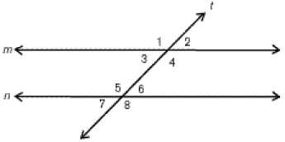
Diagram
In the figure above, lines m and n are parallel to each other. Line t is the transversal which cuts across the pair of lines.
Alternate Exterior Angles
Angles 1 and angle 8
Angles 2 and angle 7
Alternate Interior Angles
Angles 3 and 6
Angles 4 and 5

Slide 4

Real world example - 1
Transversal – line that cut through at least two or more lines
In this satellite view of a street, we can see many examples of transversals throughout the roads. They help people find ways to travel quicker using shortcuts through the roads.

Slide 5
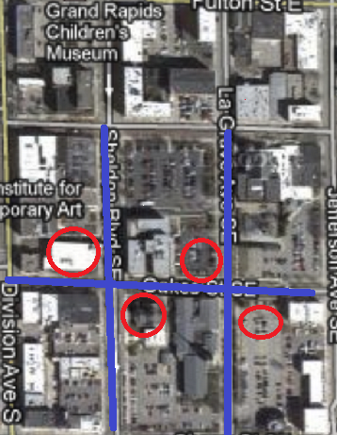
Real world example - 2
Looking at this portion of the picture of the previous slide, we can see that in this street view, not only do alternate interior and exterior angles are used mathematically but also could be used as destination points

Slide 6
Real world example - 3
In these blueprints, it is shown that transversals, alternate interior and exterior angles are also important to architects because they help during the layout as well as the construction.

Slide 7
Summary
We may think the transversal, alternate interior and exterior angles are only used in math when it isn’t true. They are just as important in the real world.
Overall, these three terms are important to our everyday lives even though it may not seem like it. We use them and see them around without even realizing just how much they’ve done for us. Buildings and roads are just two of the many ways transversals, alternate interior and exterior are used in the real world

