Slide 1
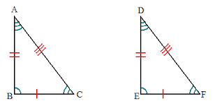
CPCTC
Sierra Christensen
Period: 6

Slide 2
DEFINITION
CPCTC is an acronym for corresponding parts of congruent triangles are congruent. CPCTC is commonly used at or near the end of a proof which asks to show that two angles or two sides are congruent.
In simpler terms... Corresponding parts: ≅ ≅

Slide 3
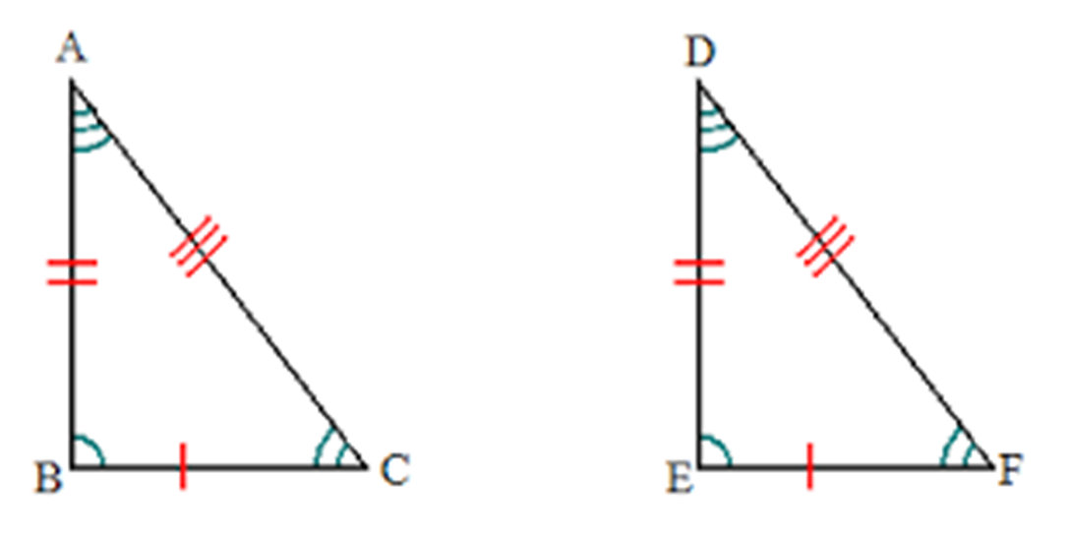
Diagram of CPCTC

Slide 4
Why is this important in the real world?
This video gives the basics as to how CPCTC used in the real world.
https://www.youtube.com/watch?v=o0sUS6stWRw

Slide 5
Congruence

