Slide 1
Conjectures,
Theorem, and
Counterexample
By: Pau Thang

Slide 2
Conjectures
Conjectures -
an opinion or conclusion formed on the basis of incomplete information

Slide 3
In other words, conjectures are
It is the use of logic to determine the future.
educated guesses.
Figure 1

Slide 4
Since conjectures are the use of logic, we use it all the time.
For example, if it is windy and cloudy, we can assume that a storm is on its way.
Windy + Cloudy
Storm

Slide 5
Theorem
a general proposition not self-evident but proved by a chain of reasoning; a truth established by means of accepted truths.

Slide 6
What is Theorem?
Theorems are educated guesses based on past events.
In a way it’s very similar to conjectures,
but different at the same time.
The huge difference is that theorems are based by facts from the past.

Slide 7
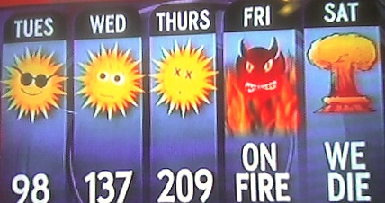
For example, we can guess that Phoenix will be hot in the summer,
because it always has.

Slide 8
Counterexample
A counterexample is a special kind of example that disproves a statement or proposition.

Slide 9
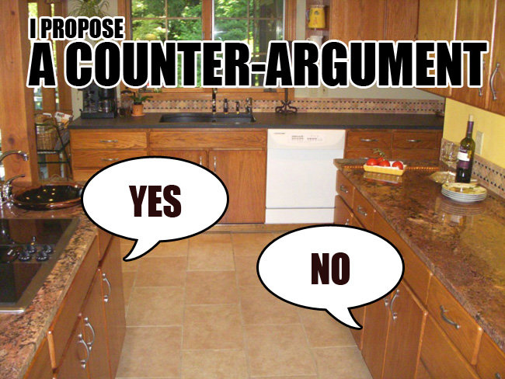
For example, if someone state something that is unreal, we can counter-argue it with facts and real evidence.

