Slide 1
Exterior Angles

Slide 2
Definition
An exterior angle of a polygon is an angle that forms a linear pair with one of the angles of the polygon.

Slide 3
Theorem
Theorem: The measure of an exterior angle of a triangle is greater than either of its two non-adjacent interior angles.

Slide 4
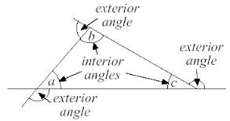
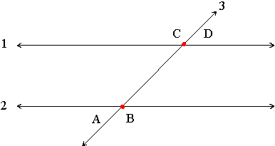
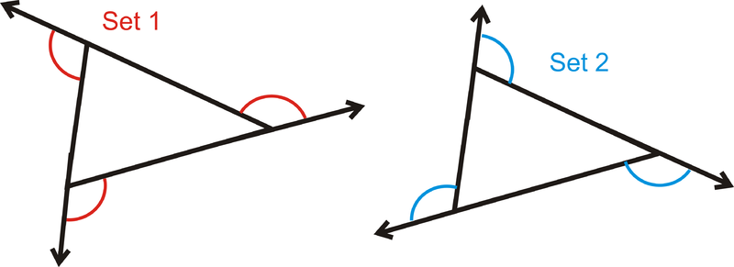
diagram

Slide 5
Why important in life?
in measuring distances between countries and cities. Angles are used very often to refer to a distance on the earth.
In the building trade to make windows ,doors, and roof angles.
Architecture cannot be created without using angles and their measures.

Slide 6
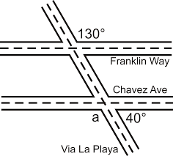
Real life example

Slide 7
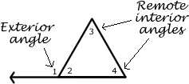
Remote Interior Angles
An exterior angle is an angle on the outside of a triangle formed by extending one of the triangle's sides. Each interior angle of a triangle has two remote exterior angles and an adjacent interior angle.
The remote interior angles are the two angles inside the triangle that do not share a vertex with the exterior angle

