Slide 1
Triangle Inequality Theorem and Side Angle Relationship in Triangle

Slide 2
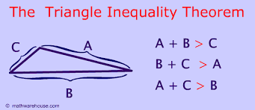
Triangle Inequality Theorem
The triangle inequality theorem states that any side of a triangle is always shorter than the sum of the other two sides.

Slide 3
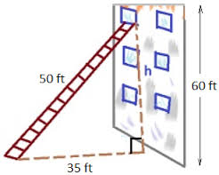
Triangle Inequality Use in Real Life
In order to built a right letter to the third window we need to know the length and the base of
Wall and the ground. The length and the base have to add up more the third side

Slide 4
The Relationship Between Side Angle and Triangle
The shortest side is always opposite the smallest interior angle
The longest side is always opposite the largest interior angle

Slide 5
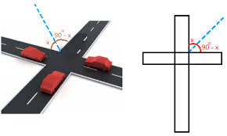
Real Life of Side Angle Relations in Triangles
To make a rode we need to know the measure of the angle and
and the said. As u see the angle of the road is 90 degrees
and it helps shows that the other side are the same.

