Slide 1
Centroid Theorem
By Mario rodriguez

Slide 2
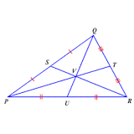
The centroid of a triangle is the point where the three medians coincide. The centroid theorem states that the centroid is of the distance from each vertex to the midpoint of the opposite side.

Slide 3
To find the centroid of a triangle, draw a line connecting a vertex to it’s opposite midpoint. Do this to all three vertices of the triangle. The centroid is where all three lines intersect.

Slide 4
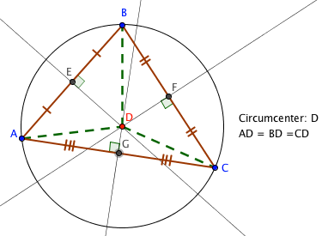
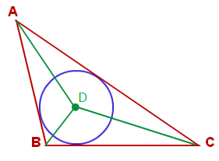
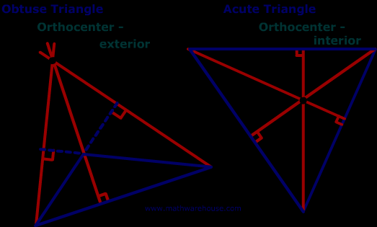
Circumcenter, Incenter, and Orthocenter
The circumcenter is the point where the three perpendicular bisectors of the sides of a triangle meet.
The incenter is one of the triangle's points of concurrency formed by the intersection of the triangle's 3 angle bisectors. These three angle bisectors are always concurrent and always meet in the triangle's interior
The orthocenter is one of the triangle's points of concurrency formed by the intersection of the triangle's 3 altitudes. These three altitudes are always concurrent.

