Slide 1
inscribed theorems
By:Maria Toledo

Slide 2
inscribed theorems include...
incircles are circles or a circle inscribed in a triangle or other figure so as to touch but not cross each side
incenters is the center of the incircle of a triangle or other figure
incenter theorem is the meeting point of the three angle bisectors

Slide 3
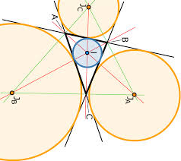
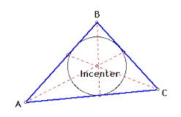
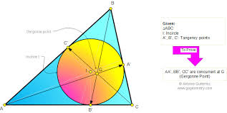
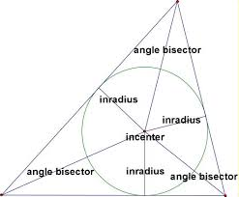
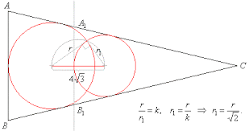
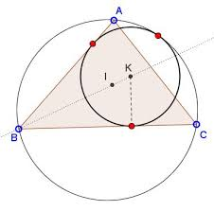
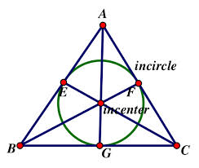
examples of inscribed theorem

Slide 4
How is this used in real life?
Inscribed theorem is used in real life for when you’re trying to put something in the middle of three things or locations, so it can be in reach if you were to be in any of those other three places .

Slide 5
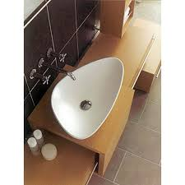
real life examples
as you can see here this sink was made as a triangle. they used the inscribed theorem to figure out where to put in the draining tube and all so that the incenter would be in the center of the triangle and all the angle bisectors would meet at that point.

Slide 6
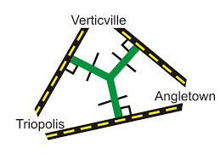
real life examples
this is another example on inscribed theorem. these roads form into a triangle. this happens rarely but being imaginative say you wanted to put a store there. but you want it specifically in the incenter because it’s where you believe will be more attraction and people. so by using the theorem you find the incenter and decide to open up your store there.

Slide 7
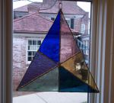
sometimes even decorations use inscribed. like this stained glass window shaped as a trinagle has the lines used to find
the incenter. the lines shown on the glass are the angle bisectors that connect to the incenter. if you would connect three of those specific lines you would get your incircle like the image shown below does.

Slide 8
video
https://www.youtube.com/watch?v=NRzlh6KM0Lg
here is a youtube video showing you how to inscribe a circle in a triangle, if you are wondering.

