Slide 1
transversal, corresponding angles, and consecutive interior
By Marco Ayon

Slide 2
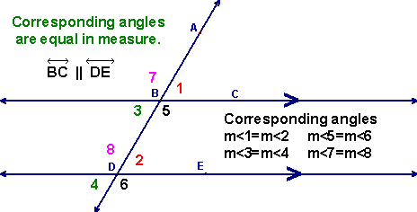
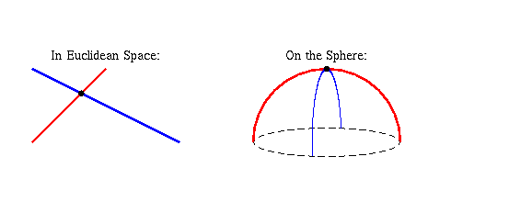
Transversal corresponding angles
a transversal is a line that passes through two lines in the same plane at two distinct points. Transversals play a role in establishing whether two other lines in the Euclidean plane are parallel (Euclidean space encompasses the two-dimensional Euclidean plane)When two lines are crossed by another line (which is called the Transversal), the angles in matching corners are called corresponding angles. When the two lines are parallelCorresponding Angles are equal.

Slide 3
transversal corresponding angles
here is an example of a transversal corresponding angles.
https://www.youtube.com/watch?v=iMINKDZk-uM

Slide 4
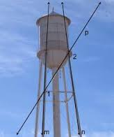
real world of transversal corresponding angles

Slide 5
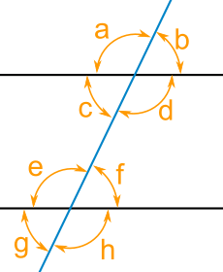
consecutive interior
When two lines are crossed by another line (which is called the Transversal), the pairs of angles on one side of the transversal, but inside the two lines are called Consecutive Interior Angles.
c+e=180
d+e+180

Slide 6
consecutive interior
here an example of consecutive interior.
https://www.youtube.com/watch?v=e_Nt2JitPFU

Slide 7
real world consecutive interior

