Slide 1
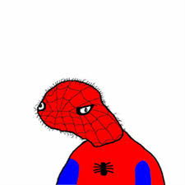
Rectangle and Square
Korina Yancey

Slide 2
Square
o k
a plane figure with four equal straight sides and four right angles
square up gooby

Slide 3
Rectangle
a plane figure with four straight sides and four right angles, especially one with unequal adjacent sides, in contrast to a square.
this is a rectangle
there are 4 dolan sides
hey gooby
sup

Slide 4
Theorem & Property (Square & Rectangle)
A square is a parallelogram with four congruent sides and four right angles. A quadrilateral is a square if and only if it is a rhombus and a rectangle
Theorem:If a parallelogram is a rhombus, then the diagonals are perpendicular.
Properties
The diagonals of a square bisect each other and meet at 90°
The diagonals of a square bisect its angles.
Opposite sides of a square are both parallel and equal in length.
All four angles of a square are equal. ...
All four sides of a square are equal.
The diagonals of a square are equal.
what is this

Slide 5
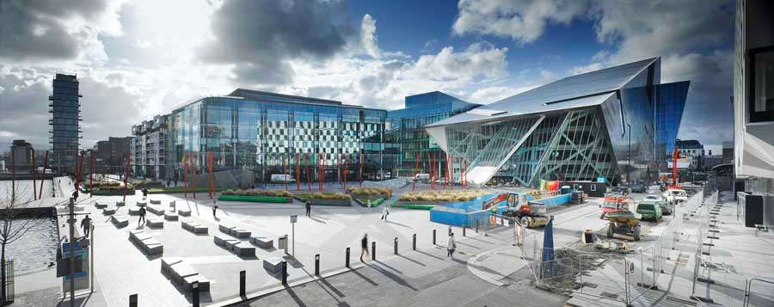
Real life uses
Squares and rectangles are used for many different purposes in real life. The shape is most commonly used in architecture. As seen in the picture below squares and rectangles are everywhere. The building in the center is one big rectangle supported by its planes.
hey bogs
y iz a math bek always unhappi
i d k

Slide 6
.
dont b so negutiv gooby
k
wen will my wyf return frum war
that wuz a dum jok
becuz it had so many problms

