Slide 1
Circumscribed, Circumcircle and Circumcenter Theorems
By: Kiersten engelking
p.6

Slide 2
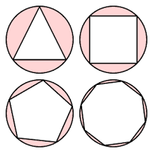
Circumscribed:
https://www.khanacademy.org/math/geometry/cc-geometry-circles/central-inscribed-circumscribed/e/central--inscribed--and-circumscribed-angles
Definition: Drawing a figure around another, touching all points but not cutting it.
Theorem: The central angle subtended by two points on a circle is twice the inscribed angle subtended by those points.

Slide 3
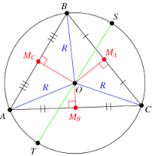
Circumcircle:
In this example, it’s directly identical to the definition because all vertices of the polygon in this case a triangle, go through the circle.
In this example the theorem would be; all triangles are cylic.
Definition: A circle which passes through all vertices of the polygon.

Slide 4
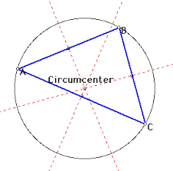
Circumcenter:
https://www.khanacademy.org/math/.../v/circumcenter-of-a-triangle
Definition: The point at which the perpendicular bisectors of the sides of a triangle intersect and which is equidistant from the three vertices.
Theorem: The vertices of a triangle are equidistant from the circumcenter.

