Slide 2
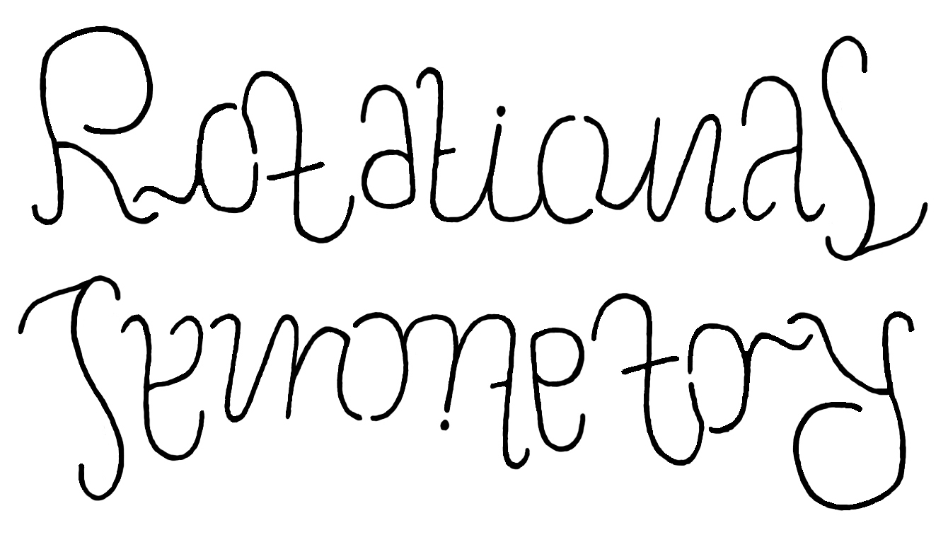
A shape has Rotational Symmetry when it still looks the same after a rotation (of less than one full turn).
This image can be rotated to three different positions and each look the same. It has Rotational Symmetry of Order 4.

Slide 3
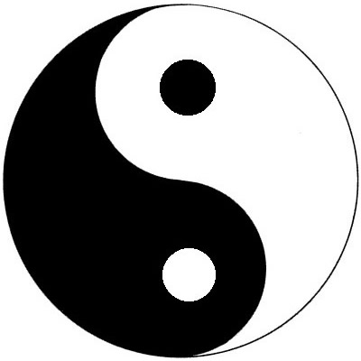
Color and Rotations
The Yin-yang symbol here is to show you that colors used in an image may play a role. If we ignore the fact that one side is black and the other is white, then this image has 2 rotational symmetry. If we do look at the colors, the symbol does not have rotational symmetry. Some people would say that the yin-yang symbol has 2-fold rotational symmetry, but has no color rotational symmetry. In our discussions of patterns and their symmetry we tend to ignore the colors used.

Slide 4
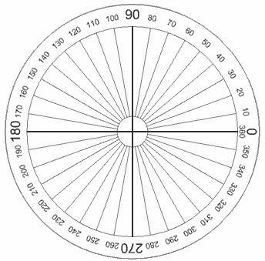
Rotational Degrees
Full Circle Degrees
The Full Circle
A Full Circle is 360°
Half a circle is 180°
(called a Straight Angle)
Quarter of a circle is 90°
(called a Right Angle)

Slide 5
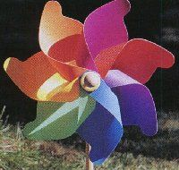
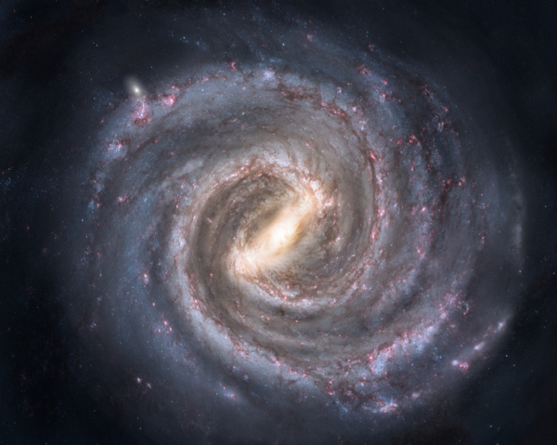
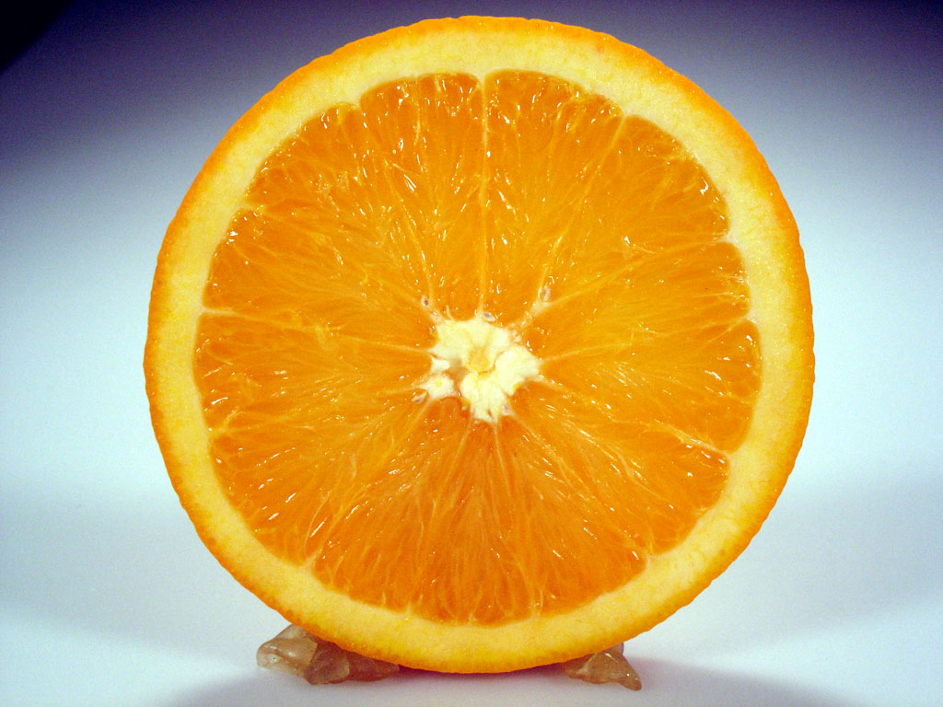
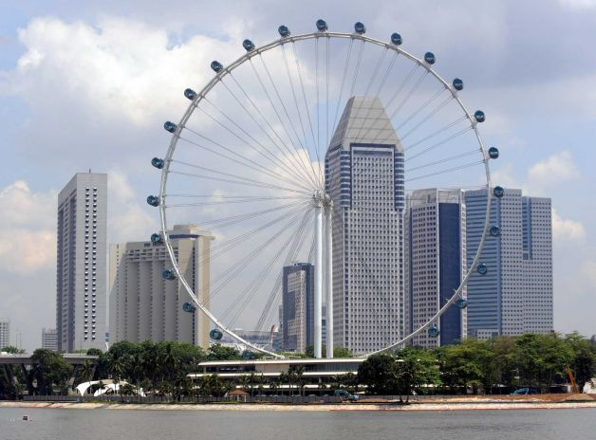
Real World Examples

