Slide 1
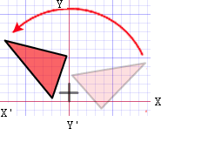
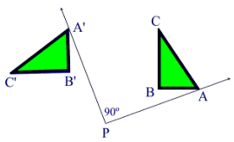
Rotation
Rotation / Angle of Rotation / Center of Rotation

Slide 2
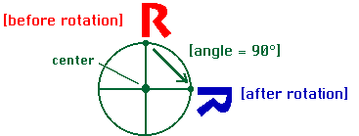
Definition of Rotation
The action of rotation around an axis.
A transformation in which a plane figure turns around a fixed center point.

Slide 3
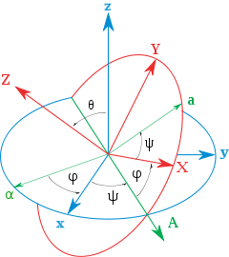
Rotation Theorem
Euler's rotation theorem states that, in three-dimensional space, any displacement of a rigid body such that a point on the rigid body remains fixed, is equivalent to a single rotation about some axis that runs through the fixed point.
It also means that the composition of two rotations is also a rotation.

Slide 4
Rotation Properties
distance is preserved (lengths of segments are the same)
angle measures (remain the same)
parallelism (parallel lines remain parallel)
collinearity (points stay on the same lines)
midpoint (midpoints remain the same in each figure)
orientation (lettering order remains the same)

Slide 5
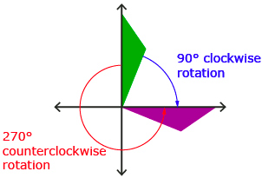
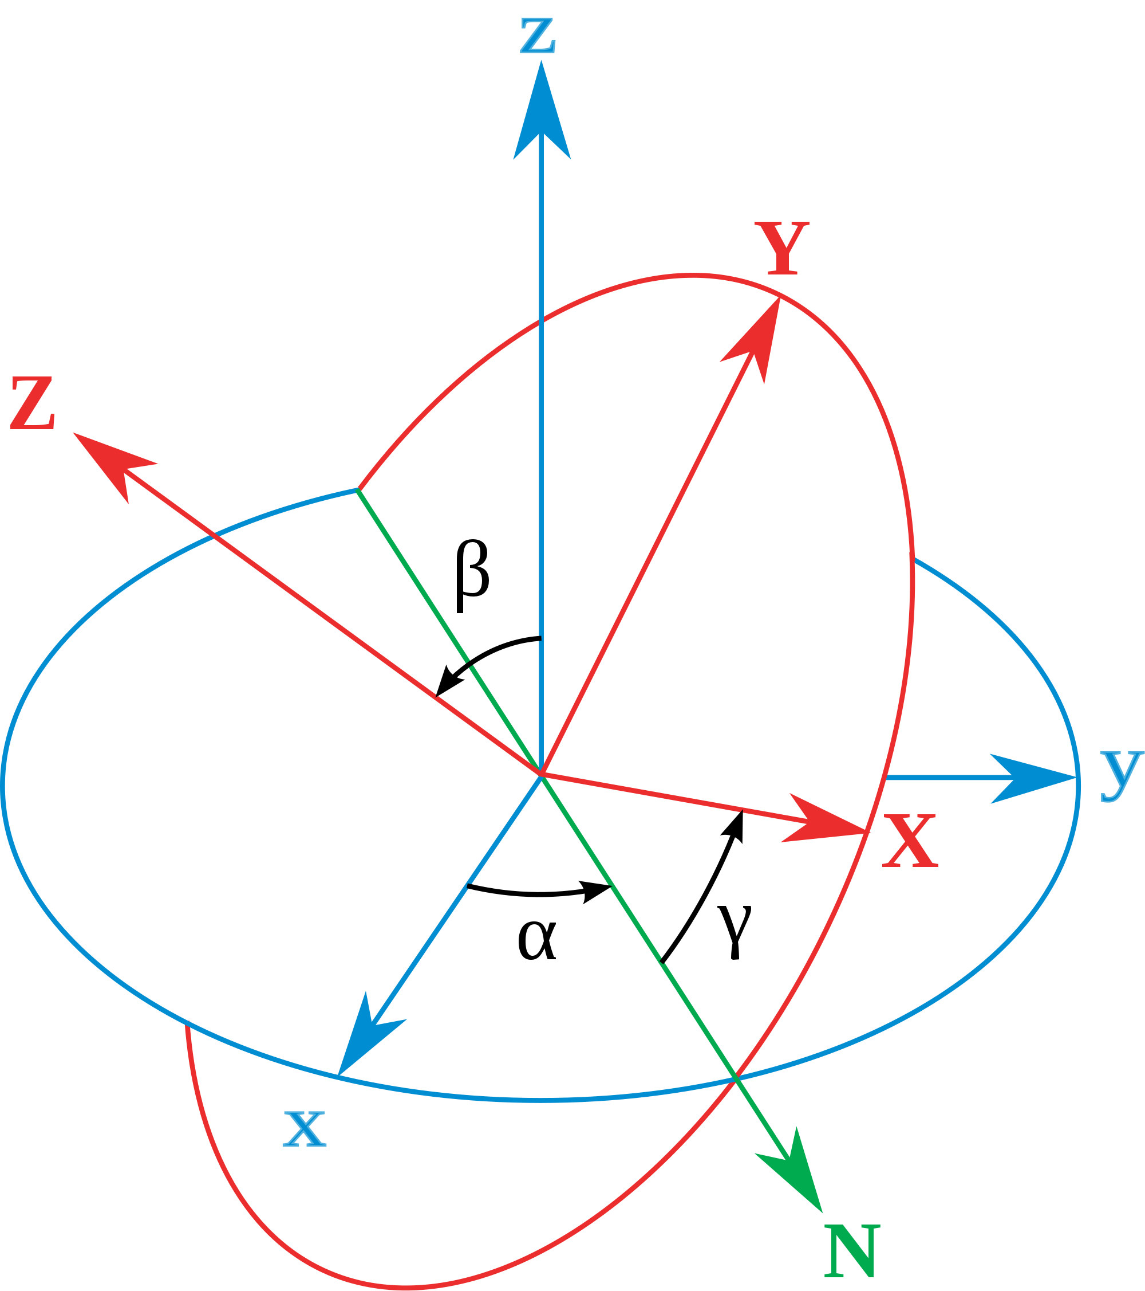
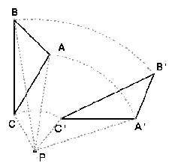
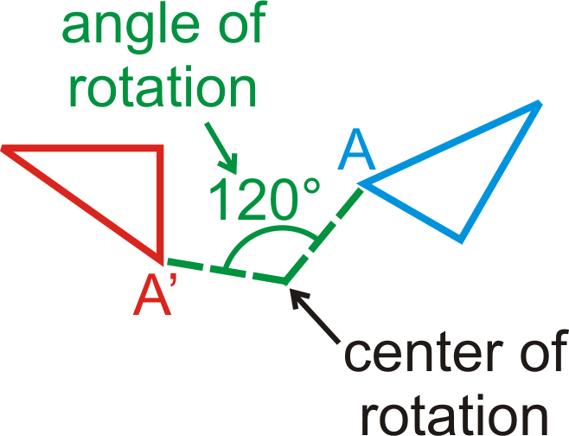
Rotation Diagrams

Slide 6
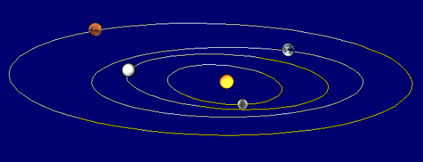
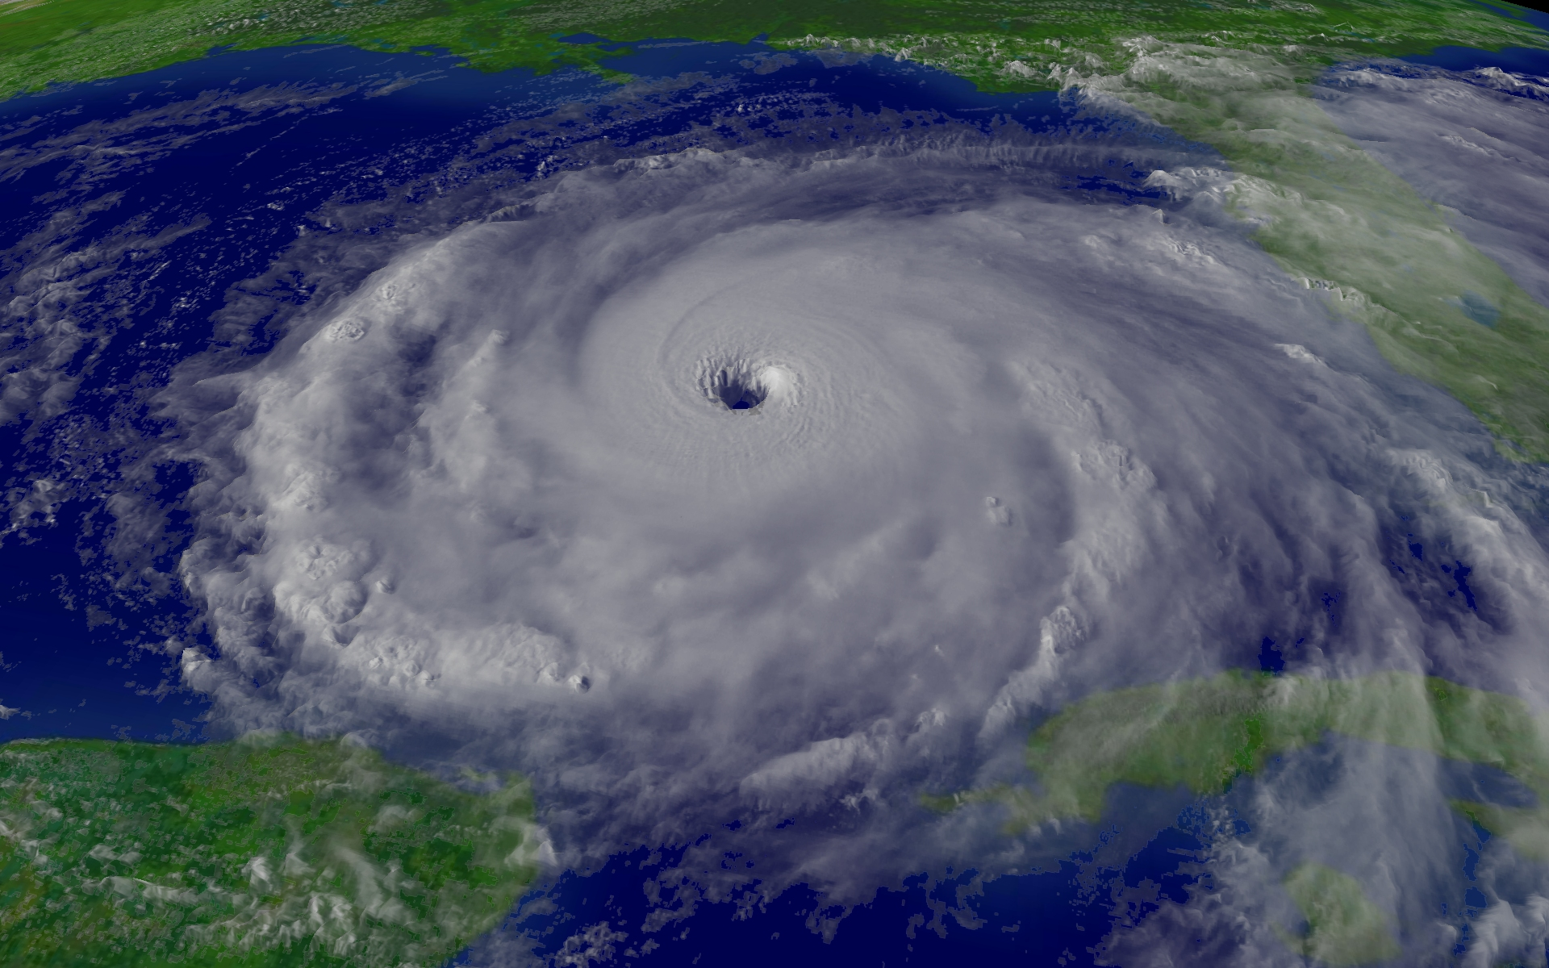
Real Life Rotation
The solar system is one example of a real life rotation. The planets rotate around the sun, the center.
Hurricanes are another example of rotation in real life. The wind and water rotates around the eye of the hurricane or the center.

Slide 7
Real Life Rotation
The ferris wheel is one way we can see how the properties of rotation come into play.
The distance never changes, the midpoint stays the same.
Nothing changes to keep the rotations congruent.

Slide 8
Thank you!

