Slide 1
What Are Linear Pair
and Vertical Angles?
Linear Pair:
A pair of adjacent angles
created when two lines intersect.
Vertical Angles:
The angles across from each
other when two lines intersect.

Slide 2
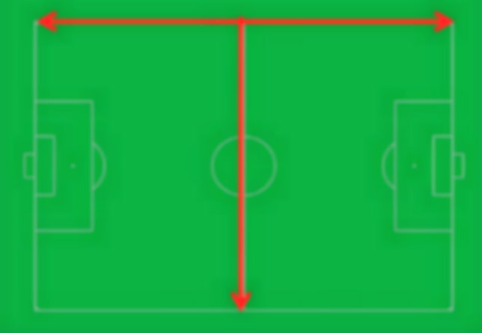
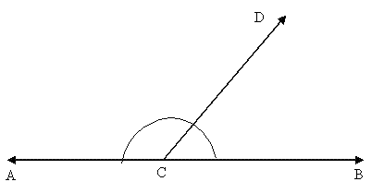
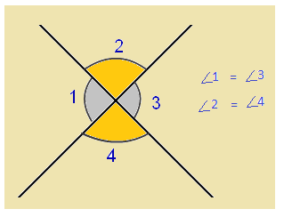
EXAMPLES OF LINEAR PAIR AND VERTICAL ANGLES
LINEAR PAIR
VERTICAL ANGLES
This example is a linear pair because
$\overline{ACD}$ is adjacent (across) of $\overline{DCB}$.
Also, It is important to understand
that these two pairs are supplementary (180$°$) if added together. This is often called as the LINEAR PAIR THEOREM.
This image is an example of vertical
angles because in order for <1 to equal
<3, they have to be across from each other. This is the same with <2 equaling <4. This is called the VERTICAL ANGLE THEOREM. From precious learning of the linear pair, you should know that
<1+<2= 180$°$ because they are adjacent angles.

Slide 3
HOW ARE LINEAR PAIR AND VERTICAL ANGLES USED IN REAL LIFE?
WHY ARE THEY IMPORTANT?

Slide 4
LETS USE THIS MAP
A
B
D
C
Let’s say we are trying to find the distance of A,B, and C. We know D equals half a mile and that A and D equals 1 mile and it is a straight street. Using the vertical theorem we know D = B, meaning B also equals ½ a mile. The pair of A and D is the Linear Pair Theorem because it equals a straight line or 180$°.$ From using both the linear pair theorem and vertical theorem, we know all of the rest equals ½ mile also. This proves that we can use these theorems to find distance and so many other things.

