Slide 1
Median & Centroid, with Centroid theorem
Presented By: Karen Lopez

Slide 2
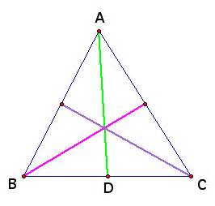
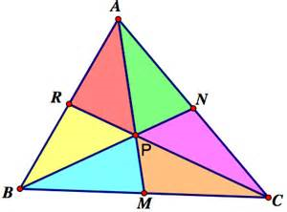
Definition
Median of a triangle:
line segment connects the midpoint of opposing side
Triangles have particularly 3 medians
All medians intersect each other at triangle’s centroid
Centroid of a triangle:
Intersection of the exact 3 medians of a triangle
the median divides the triangle equally into 2 smaller triangles
Theorem
The centroid is exactly 2/3 the way along each median

Slide 3
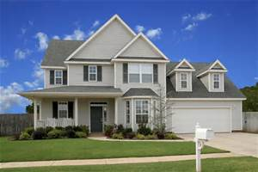
Real Life Uses
A carpenter uses the centroid of the table to find the center of gravity of the triangular table
When they manufacture Doritos they have to find the centroid.
Many engineers use the centroid to build the top of a house

Slide 4
credits
https://sites.google.com/site/themathematicsbehinddoritos/real-life-examples

