Slide 1
Equiangular and equilateral triangle and there postulate
By Jaqueline Hernandez
Period-6

Slide 2
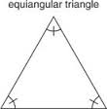
Diagram of an equiangular and equilateral triangle

Slide 3
Equilateral and Equiangular triangle definition
An equiangular triangle is a triangle where all three interior angles are equal in measure. Because the interior angles of any triangle always add up to 180°, each angle is always a third of that, or 60°
An equilateral triangle is a triangle in which all three sides are equal.

Slide 4
Importance in real life situations
First of all an equiangular and equilateral triangle has to do with most of our historic artifacts such as the beautiful and amazing pyramids that the Egyptians made
With that in hold, this leads to the teaching of many of ways to Construct buildings because of how these very everlasting artifacts and agriculture the Egyptians made that lasted and are still up

Slide 5
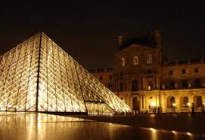
Real world Images of equilateral and equiangular triangles

