Slide 1
Triangle Midsegment and Trapezoid Midsegment, with Theorems

Slide 2
Definition of terms
Triangle Midsegment Theorem: The midpoint of two sides of the triangle create a line that is parallel to the third side
Trapezoid midsegment Theorem: Trapezoid midsegment(median) is parallel to the base of it’s length

Slide 3
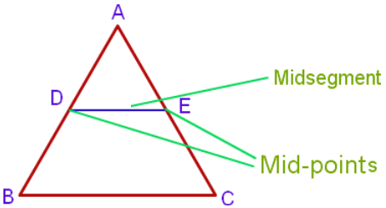
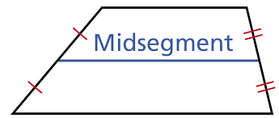
Midsegment Diagrams

Slide 4
Why midsegments are important in life?
If you needed to get to a place you would know that the midsegment is half of the base so it would save you time. It would be parallel to the base and would have all of the same angle measures. If you're building something depending on an architect's point of view. You want to know that it will be able to sustain itself and its weight.

Slide 5
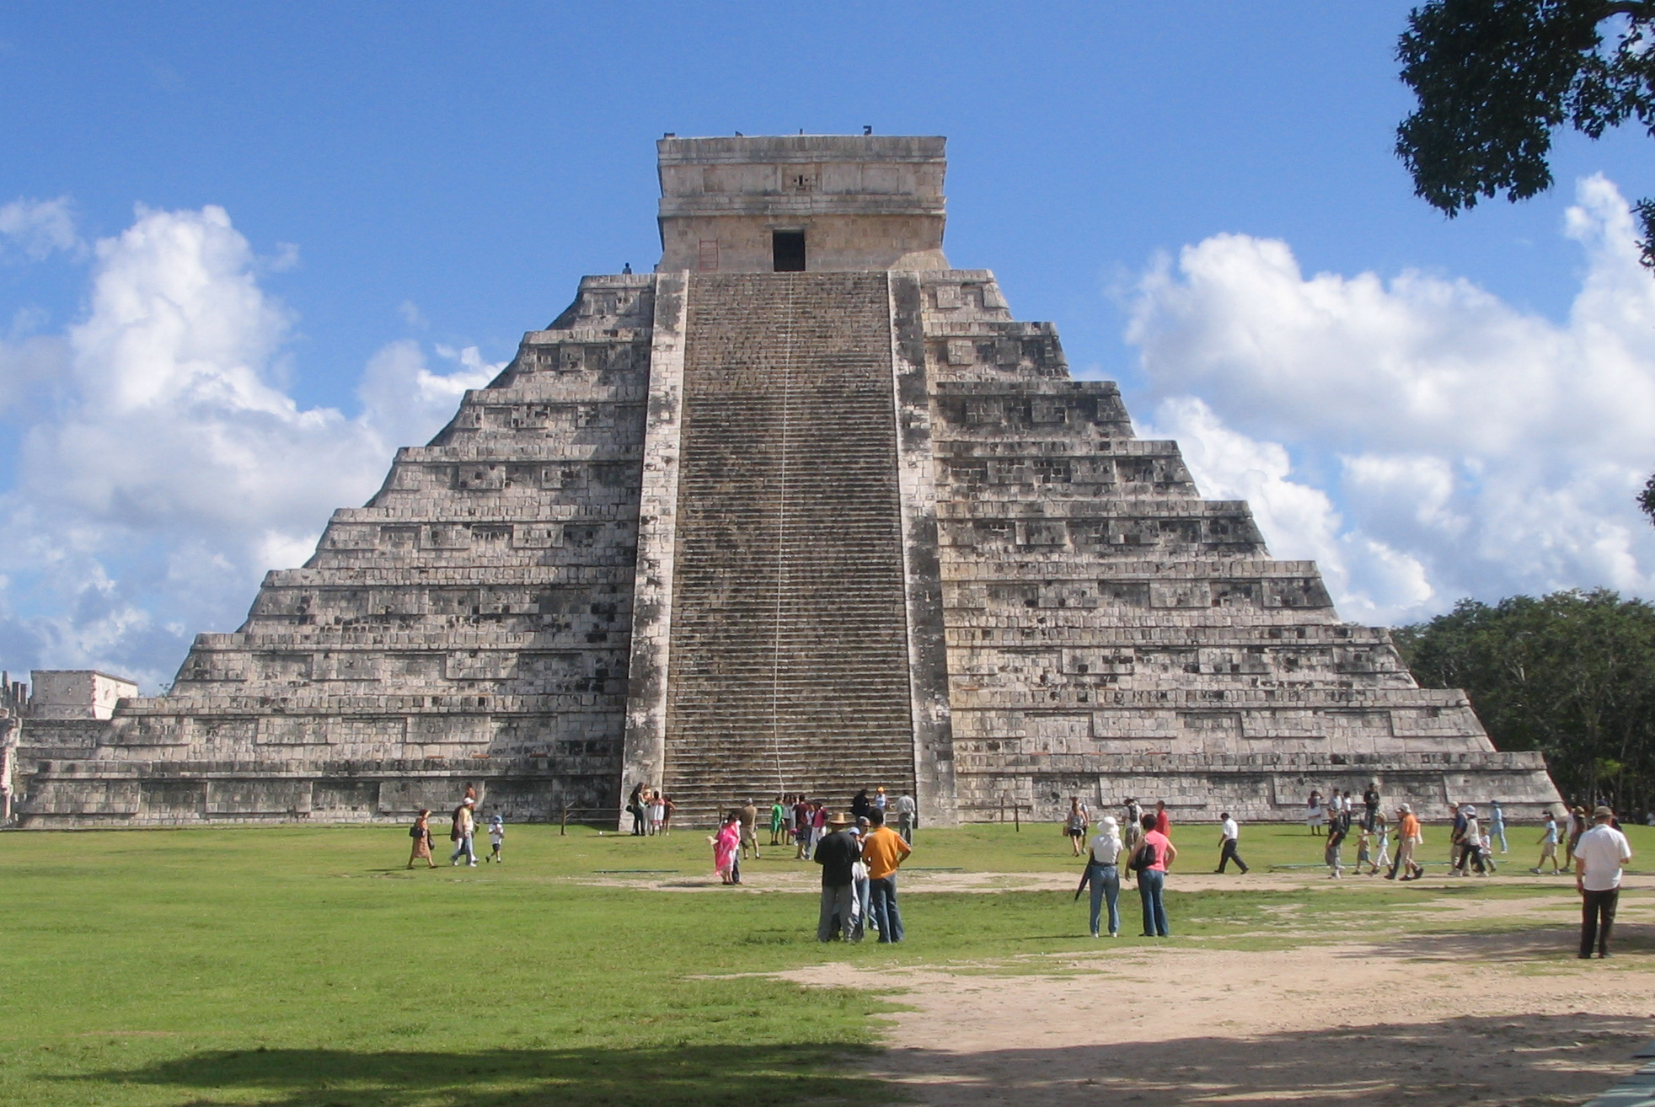
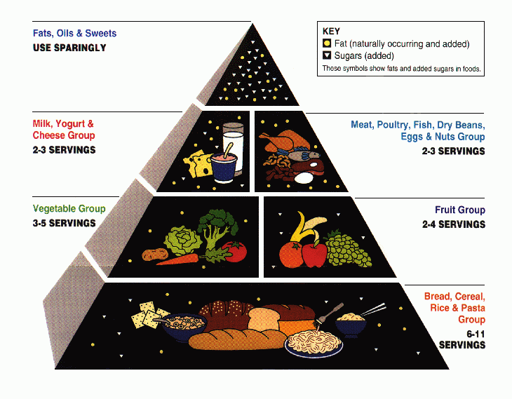
Real world pictures
Chichen Itza
Food Pyramid
Midsegment
Midsegment

Slide 6
Links for more info.
http://study.com/academy/lesson/midsegment-theorem-formula.html
http://www.regentsprep.org/regents/math/geometry/gp9/ltrapezoid.htm
http://www.geom.uiuc.edu/~dwiggins/conj20.html
http://regentsprep.org/regents/math/geometry/gp10/midlinel.htm
https://www.youtube.com/watch?v=O2bf1mZQWXI
https://www.youtube.com/watch?v=wslcvpXHaJA

