Slide 1
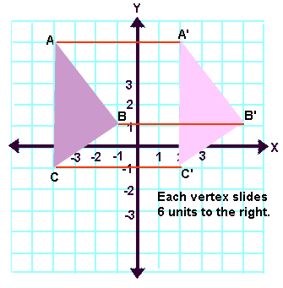
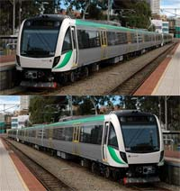
Translations
Translation is a term used in geometry to describe a function that moves an object a certain distance. The object is not altered in any other way. It is not rotated, reflected or re-sized.
A translation "slides" an object a fixed distance in a given direction. The original object and its translation have the same shape and size, and they face in the same direction. A translation creates a figure that is congruent with the original figure and preserves distance (length) and orientation.
www.youtube.com/watch?v=8QeeL4wotrQ
Real life Example: the light rail it’s the same thing just moves directions.

Slide 2
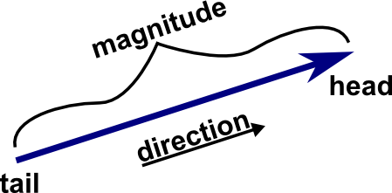
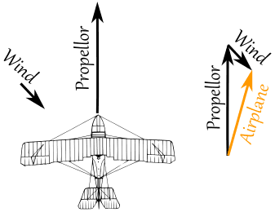
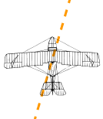
Vectors
Vector is a quantity having direction as well as magnitude, especially as determining the position of one point in space relative to another.
Real life Example: A plane is flying along, pointing North, but there is a wind coming from the North-West.
The two vectors (the velocity caused by the propeller, and the velocity of the wind) result in a slightly slower ground speed heading a little East of North.
If you watched the plane from the ground it would seem to be slipping sideways a little.
Have you ever seen that happen? Maybe you have seen birds struggling against a strong wind that seem to fly sideways. Vectors help explain that.
www.youtube.com/watch?v=pimr9I92GZY

