Slide 1
Supplementary/Complementary angles
By Erick Gonzalez
Period 4

Slide 2
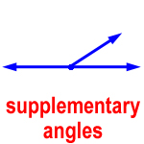
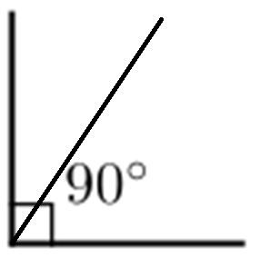
Definition
Complementary angles are two angles with the sum of 90 degrees.
Supplementary angles are two angles with a sum of 180 degrees.

Slide 3
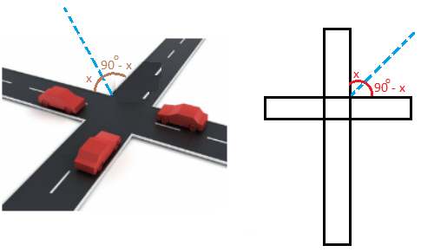
Why are they important in real life?
Complementary angles are used to create the intersections of a street.
Supplementary angles can be used to create the lines on a tennis court.

