Slide 1
Collinear & coplanar points
By: Denitzia Montano

Slide 2
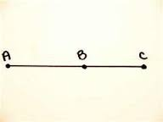
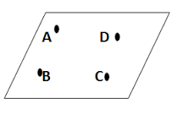
Definition of collinear & coplanar points
Three or more points are collinear if they lie on the same straight line.
Coplanar points are three or more points that lie on the same plane. Remember that a plane is a flat surface that extends with out end in all directions. Its usually a 4 sides figure.

Slide 3
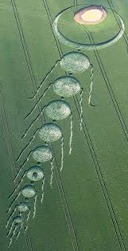
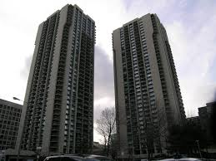
Collinear points real life examples
Real life examples of collinear points is basically anything that’s in a line. This is important in real life because we use it for architecture and basically anything we build or make.
For further information go to http://study.com/academy/lesson/collinear-points-in-geometry-definition-examples.html

Slide 4
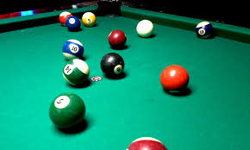
Coplanar points real life examples
When you play pool, the table would be the plan and the balls would be the different points. This is coplanar because the balls lie on the same plane. This can also be used for any other field. For example, a soccer field, football field, and a basketball court. For example, the players on the field can demonstrate the different points on a plane. You can check this video out for more explanation. www.youtube.com/watch?v=jB7Ro3w77MM

