Slide 1
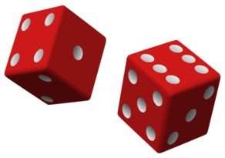
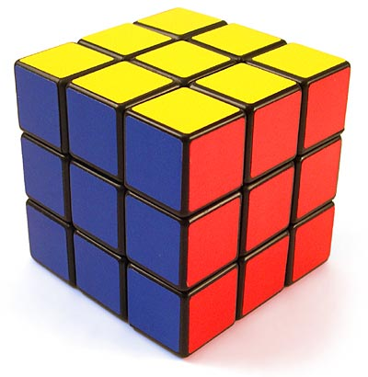
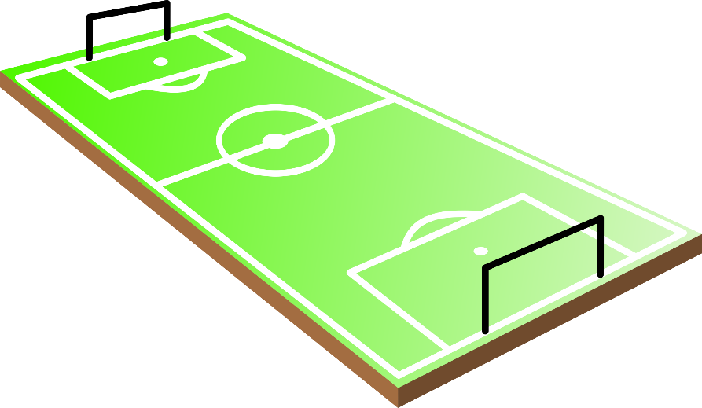
Rectangles & Squares
Daniela Gutierrez
P1
11/6/15

Slide 2
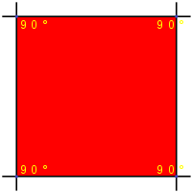
Definitions :
Square: a plane figure with four equal straight sides and four right angles.
Rectangle: a plane figure with four straight sides and four right angles, especially one with unequal adjacent sides, in contrast to a square.

Slide 3
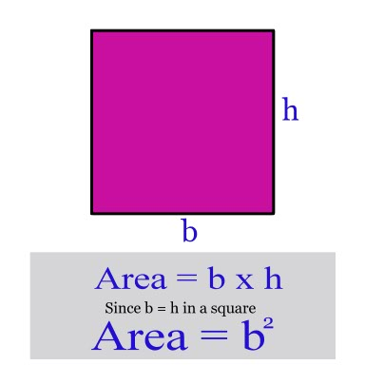
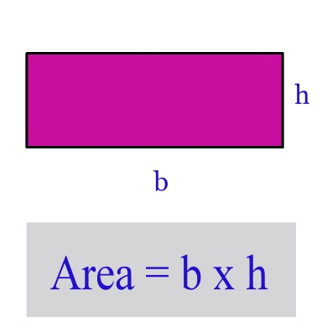
Finding the Area:
Square:
Rectangle.
: The area of a rectangle can be found by multiplying the base times the height.
The area of a square can be found by multiplying the base times itself. This is similar to the area of a rectangle but the base is the same length as the height.

Slide 4
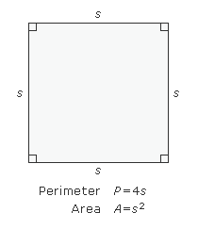
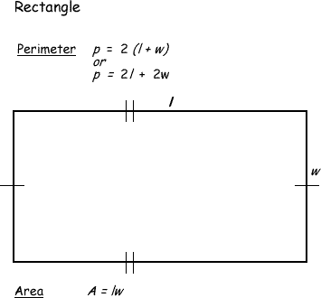
Finding the perimeter:
Square: The perimeter of a square is the distance around the outside of the square. A square has four sides of equal length. The formula for finding the perimeter of a square is 4*(Length of a Side).
Rectangle: The perimeter of a rectangle is the distance around the outside of the rectangle. A rectangle has four sides with opposite sides being congruent. The formula for finding the perimeter is Side A + Side B + Side A + Side B. This could also be stated as 2*Side A + 2*Side B or 2*(Side A + Side B)

Slide 5
Real life Examples Of Rectangles and Squares:
Some real life examples of squares include a garage, square rubber stamps, tiles on the floor.
Some real life examples of rectangles include apartment buildings, hopscotch board, certain cell phones, football fields.

Slide 6
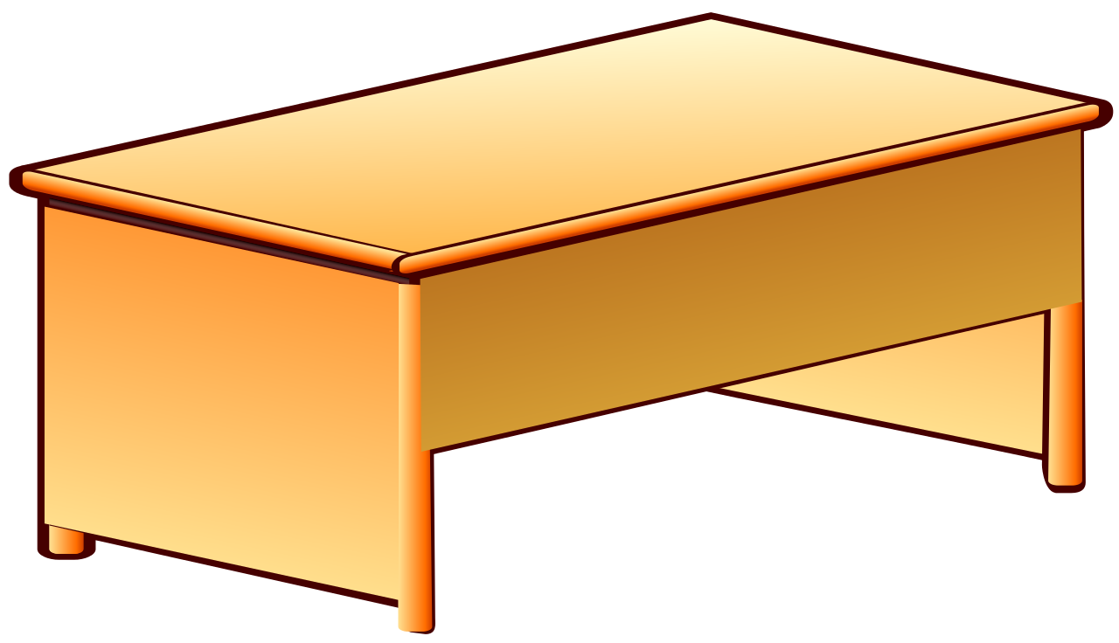
The end

