Slide 1
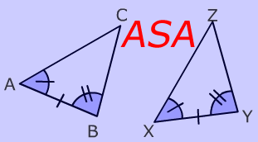
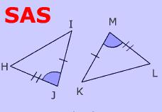
ASA and SAS Triangle Congruence Theorems
Dania Sandoval
period 6

Slide 2
What does ASA and SAS stand for?
ASA stands for:
Angle
Side
Angle
SAS stands for:
Side
Angle
Side

Slide 3
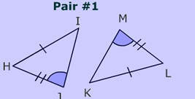
What is ASA?
ASA means that we have two triangles where we know two sides corresponding sides and their included angle is congruent.

Slide 4
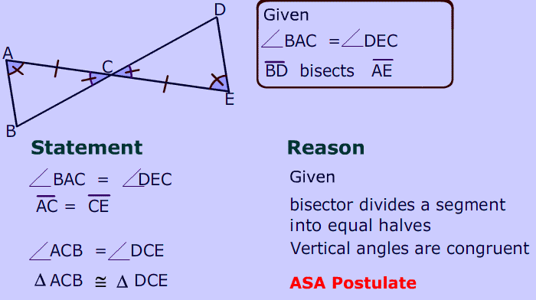
ASA Postulate
If two angles and the included side of a triangle are congruent to two angles and the included side of another triangle, then the two triangles are congruent.

Slide 5
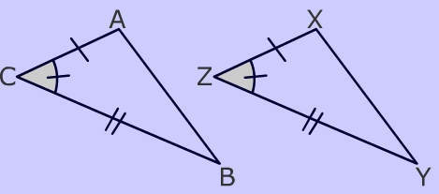
What is SAS?
SAS means that we have two sides and the included angle of one triangle are congruent to two sides and the included angle of another triangle, then these two triangles are congruent

Slide 6
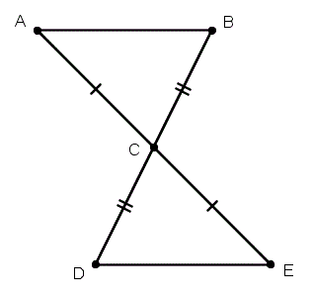
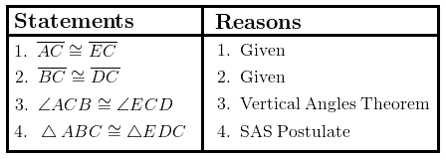
SAS Postulate
If two sides and the included angle of one triangle are congruent to the corresponding parts of another triangle, then the triangles are congruent.

Slide 7
Why are these theorems important?
Theorems are important because they help us identify the congruence two triangles can have using any of the triangle congruences postulates. These two help, and all we do is look at the sides and angles of a triangle. And it doesn’t just need to be in Geometry class, either. We can go around, comparing buildings using these two theorems.

Slide 8
How are these Theorems important?
These theorems are important in real life. For example, if you want to be an architect, it is important for architectural designs in order to be able to tell if one building/ part of building is congruent to the other triangular shape you are making.

Slide 9
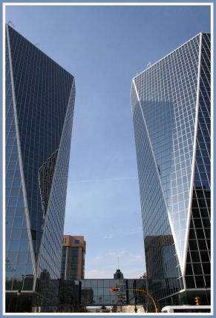
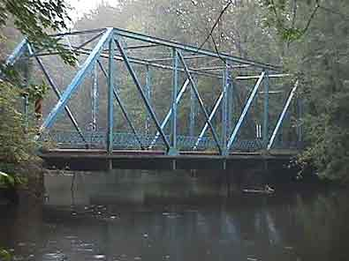
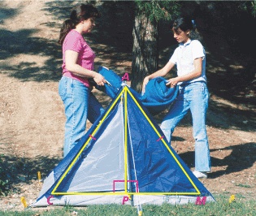
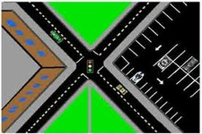
Real World Examples
ASA
SAS
SAS
ASA

