Slide 1
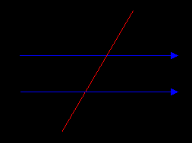
Transversals
transversal is a line that passes through two lines in the same plane at two distinct points. Transversals play a role in establishing whether two other lines in the Euclidean plane are parallel.

Slide 2
Real life uses of transversals
Transversal are used in constructions, for example, a windows or street and anything that need to be build even in nature.

Slide 3
Corresponding angles
Corresponding angles are formed when a transversal passes through two lines. The angles that are in the same position in terms of the transversal

Slide 4
Real life uses of corresponding angles
Corresponding angels are used in life is construction and building a house and interior designing.

Slide 5
Consecutive interior angles
When two lines are crossed by another line (called the Transversal): The pairs of angles on one side of the transversal but inside the two lines are called Consecutive Interior Angles.

Slide 6
Real life uses in consecutive interior angles
Consecutive interior angles used in life is building streets and anything involved with construction.

