Slide 1
Rays, line segments, and angles
By: Brittney J. Woods
Period 6

Slide 2
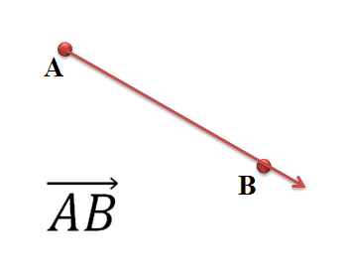
Rays
A Ray is a portion of a line that starts at a point and continues forever in one direction.
Symbol- AB

Slide 3
Real life example
The suns rays star at the sun then expand for infinity therefore creating a ray with its rays if light.

Slide 4
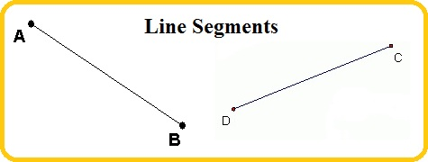
Line segments
A Line Segment is a portion of a line consisting of two points and all points between them.
Symbol- AB

Slide 5
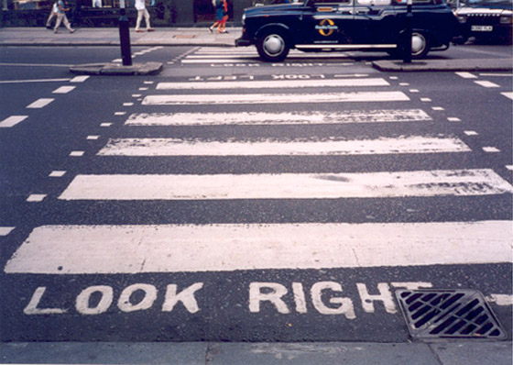
Real life example
Line Segments are important in real life because they are everywhere you go there in no way you can get away from them.

Slide 6
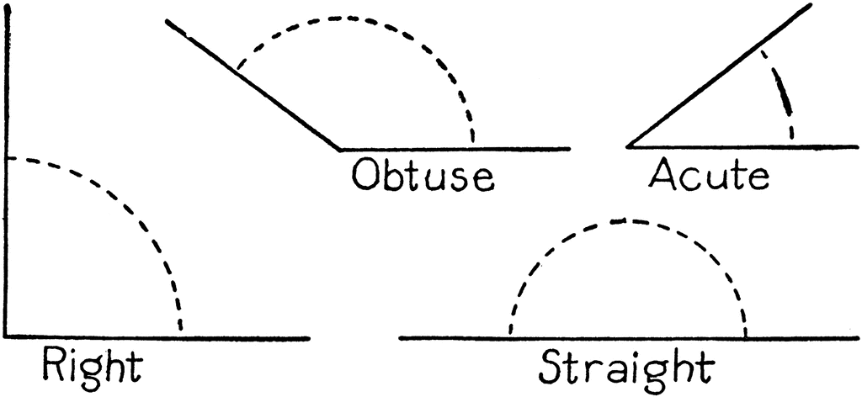
Angles
An Angle is a figure formed by two rays with the same endpoint.
Symbol- AB

Slide 7
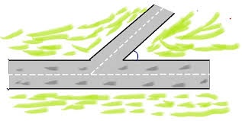
Real life example
When a road splits it causes it to become an angle and different roads have different size angles

Slide 8
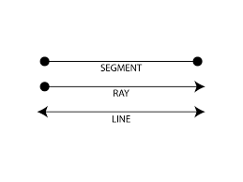
The end

