Slide 1
Transformation, RIGID MOTION, & PRE-IMAGE/IMAGE

Slide 2
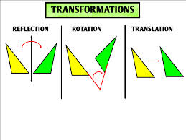
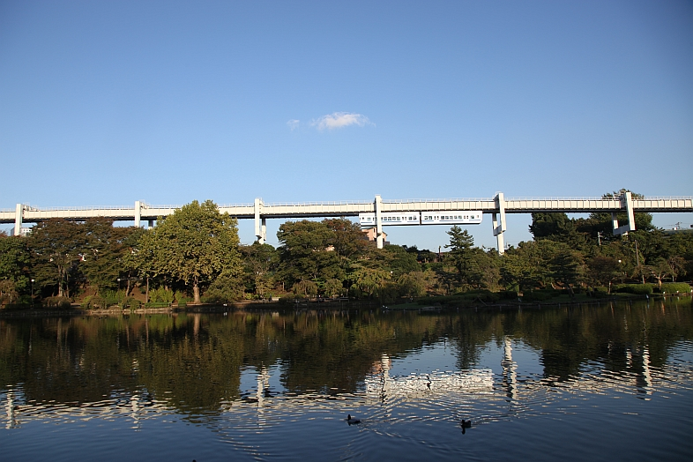
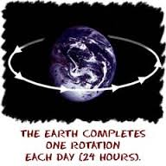
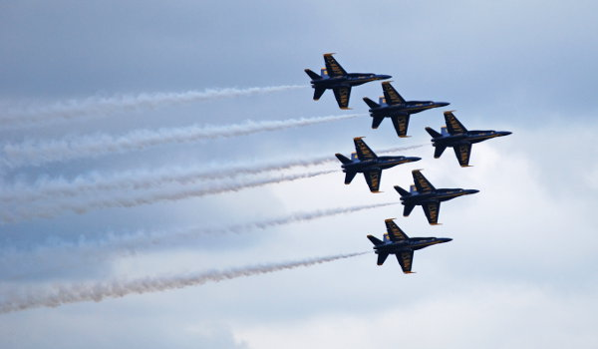
Transformation
Transformation: Process which one figure, expression or function is converted into another that’s equivalent in some important respect but its differently expressed or represented. Some examples would be rotation, reflection, and translation.
Transformation is important in real life because it can help you in various jobs. For example, mass production of shoes.

Slide 3
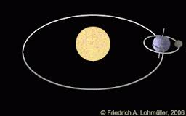
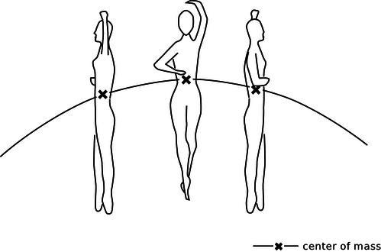
Rigid Motion
Rigid Motion: action of taking an object and moving it to a different location without altering its shape and size.
Rigid motion can be important in some professions. For example, doctors who perform surgery. They need to visually reconstruct where are they going to put the organ.

Slide 4
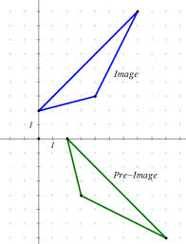
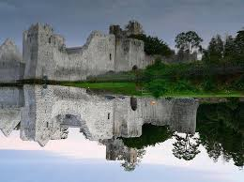
Pre-image/image
Pre-image: the figure prior to the transformation
Image: the figure after the transformation
Pre-image/image can be important because when students/sometimes even teachers can get confused and if the use the pre-image/image method they wont be anymore.

