Slide 1
Slopes Of Parallel/Perpendicular
Lines Postulates

Slide 2
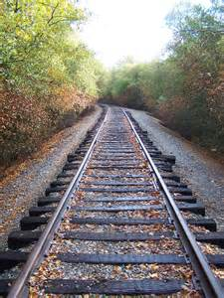
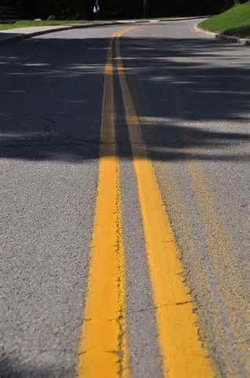
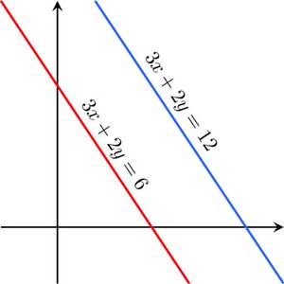
Slopes Of Parallel Lines
Parallel lines are lines that never intersect. They have the same slope but not the same intercept. The slope of parallel lines is important in real life because without it, cars wouldn’t really know where to drive. And trains wouldn’t be able to run on tracks.

Slide 3
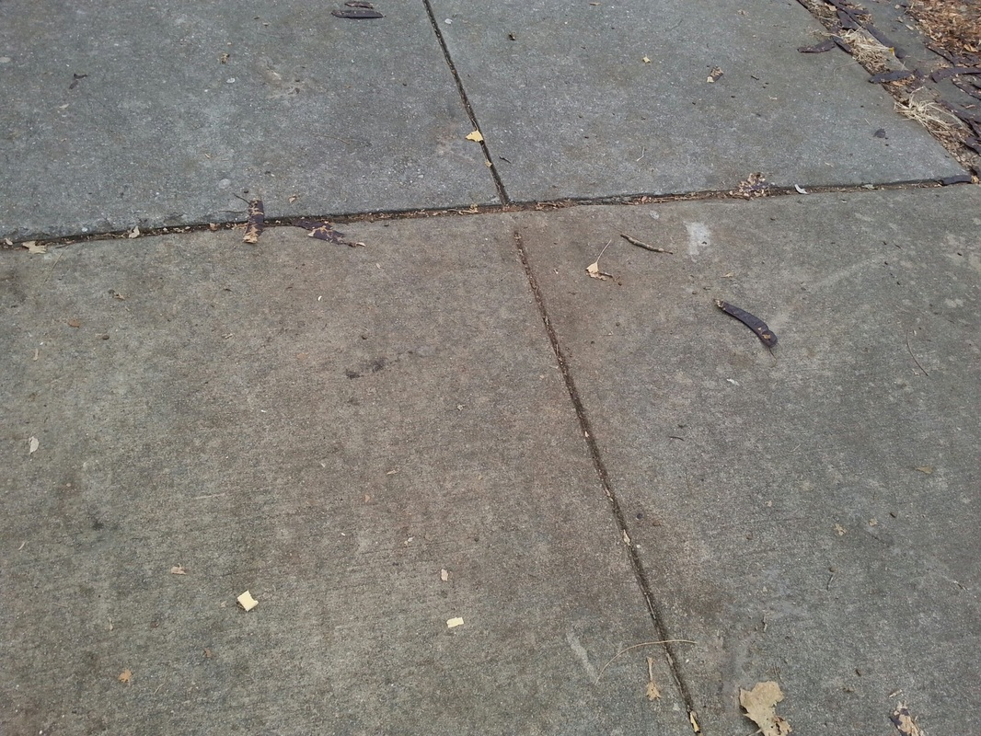
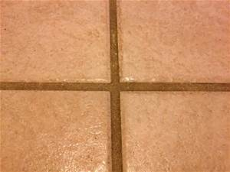
Perpendicular LInes Postulates
Perpendicular lines are lines that intersect at right angles. Perpendicular lines are important in real life because they make tiles and sidewalks look nice and neat, not messy and out of place.

