Slide 1
SSS and, AAS Triangle Congruence Theorems
BY: Ardith Archambault

Slide 2
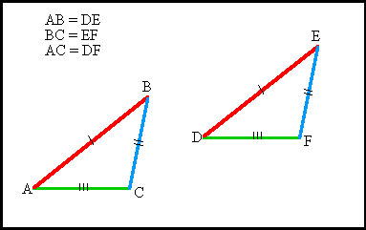
SSS Theorem
Definition: Triangles are congruent if all three sides in one triangle are congruent to the corresponding sides in the other. There are five ways to test that two triangles are congruent.
The Side, Side, Side theorem is important in real life because if you work on construction then you might have to use the (SSS) theorem

Slide 3
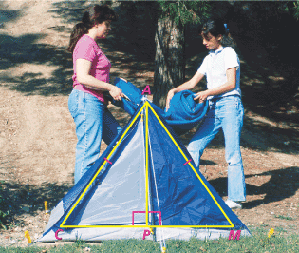
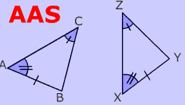
AAS triangle congruence theorems
Definition: Triangles are congruent if two pairs of corresponding angles and a pair of opposite sides are equal in both triangles. There are five ways to test that two triangles are congruent
The AAS triangle congruence theorems is important in life because you will have to learn the Angle, Angle, Side (AAS)

