Slide 1
Slope of parallel and perpendicular lines postulate
BY AMY DIETRICH

Slide 2
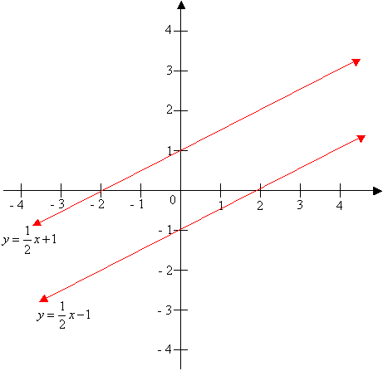
Slope of parallel line postulate
Parallel lines that have the same slope. In a coordinate plane, two non-vertical lines are parallel if and only if they have the same slope. Any two lines are parallel.

Slide 3
Real life examples of parallel lines
Math
When put on a coordinate plane, 1st street has the equation y = 6x – 7. 2nd street is parallel to 1st street and goes through the point (2, 9). Write the equation for 2nd Street in slope-intercept form.
ART

Slide 4
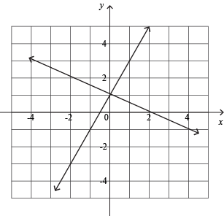
Slope of perpendicular lines postulate
Perpendicular lines have opposite negative reciprocal slopes. In a coordinate plane, two non-vertical lines are perpendicular if and only if the product of their slopes is –1. Vertical and horizontal lines are perpendicular.

Slide 5
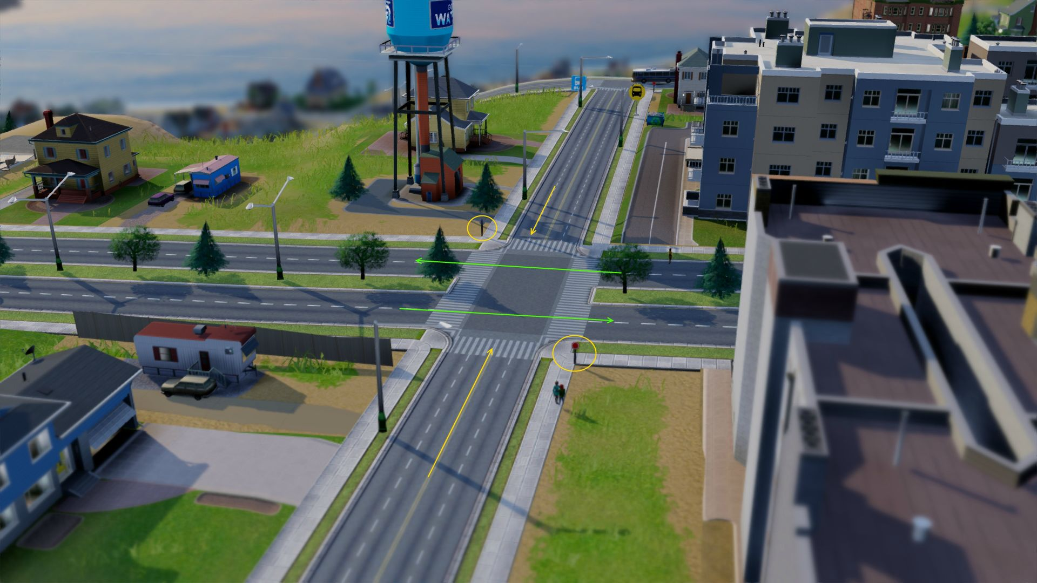
Real life examples of perpendicular lines
Math
Roads

