Slide 1
Circumscribed and Circumcenter Theorem
By; America Sanchez
Period 4

Slide 2
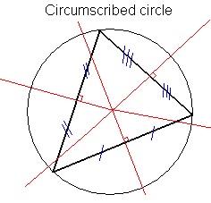
Circumscribed
A circumscribed circle or circumcircle passes through all the vertices of a plane figure and contains the entire figure in its interior .The center of this circle is called the circucmeter.

Slide 3
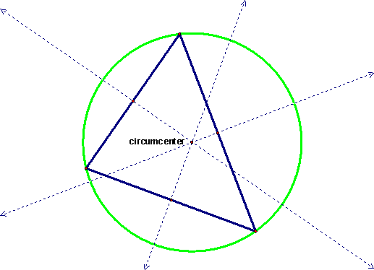
Circumcenter Theorem
The point where the perpendicular bisectors of a triangle meet is called the circumcenter.

Slide 4
Why is the circumscribed theorem important?
In coastal navigation, a triangle's circumcircle is sometimes used as a way of obtaining a position line using a sextant when no compass is available. The horizontal angle between two landmarks defines the circumcircle upon which the observer lies.

Slide 5
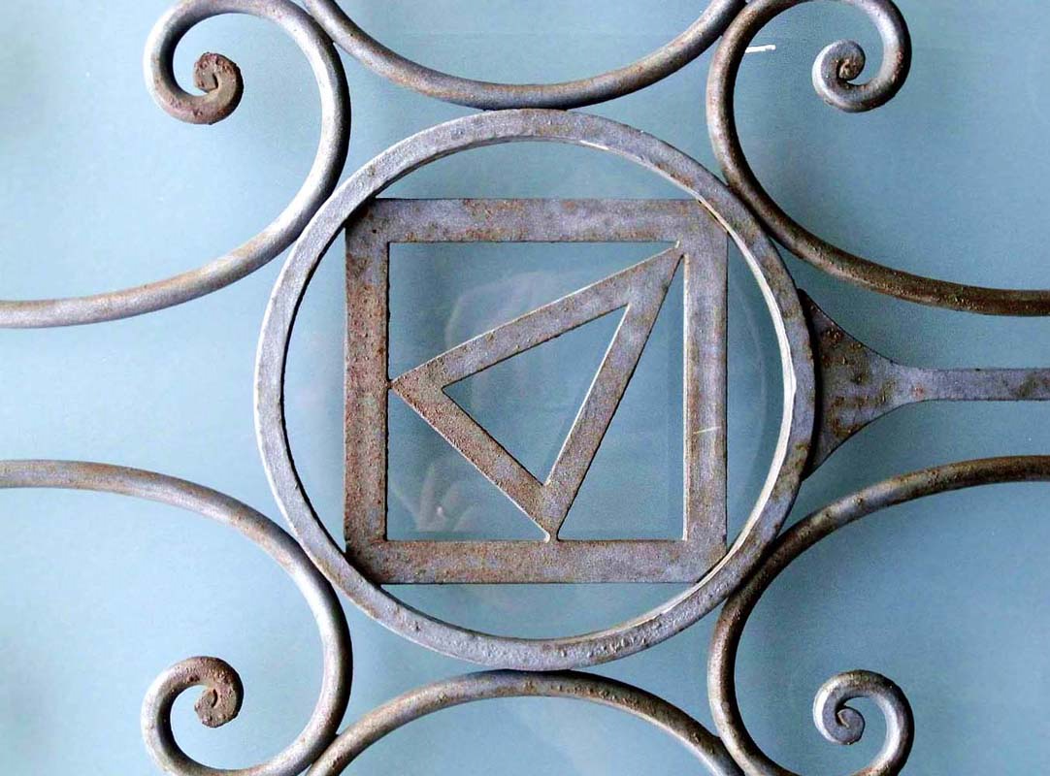
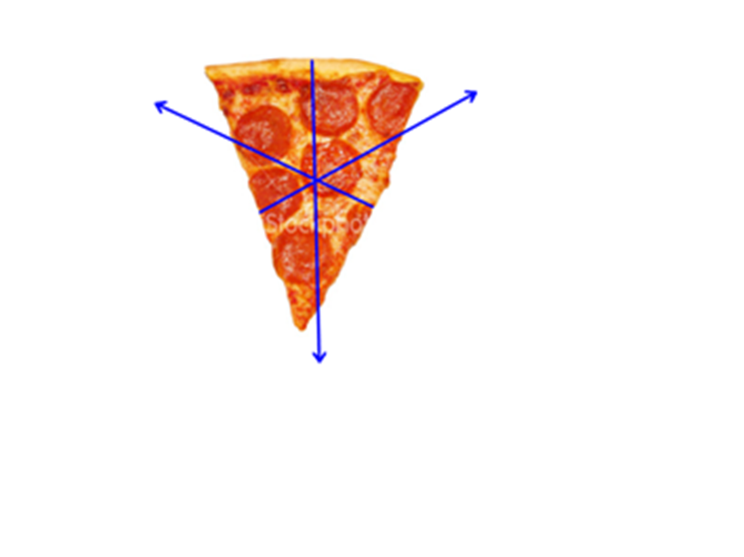
Real images of circumscribed

