Slide 1
RECTANGLE AND SQUARE
WITH PROPERTIES AND CONDITIONS

Slide 2
RECTANGLE
Definition: A 4-sided polygon where all interior angles are 90 degrees!
Properties:
Opposite sides are parallel and congruent
The diagonals bisect each other
The diagonals are congruent

Slide 3
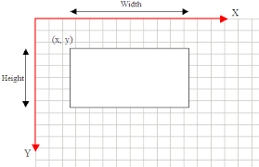
Diagram of rectangle properties

Slide 4
Importance of real life
Billboards
TV sets
DVD cases
Mobile phones
Beds
Books
Fields
Gardens
Pools
It is important for the real life because it is good for architecture and many things are into the rectangle shape.

Slide 5
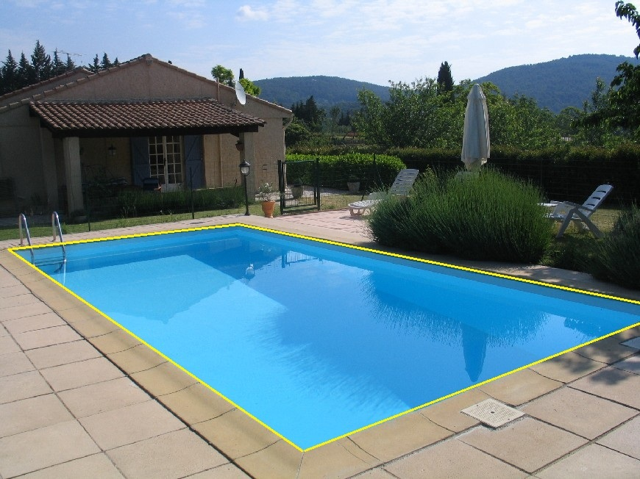
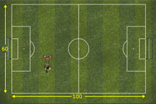
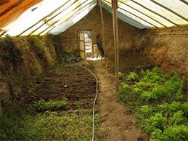
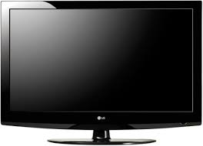
Pictures of real world examples

Slide 6
square
Definition: A plane figure with 4 equal straight sides and four right angles
Properties:
The diagonals of a square bisect each other and meet at 90 degrees
The diagonals of a square bisect its angles
Opposite sides of a square are both parallel and equal in length
All 4 angles are equal
All 4 sides are equal
The diagonals of a square are equal

Slide 7
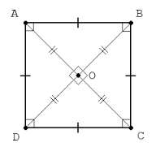
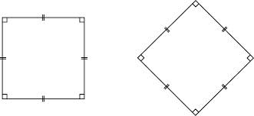
Diagram of square properties

Slide 8
Importance of real life
Tables
Computers
Windows
Floor Design/ Tiles
Boxes
Cubes
Plates
Fence
Sticky Notes
Picture frames
It is important for the real life because many things are made into the shape of a square for specific reasons, for instance, floor tiles or windows made by architects.

Slide 9
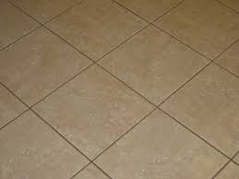
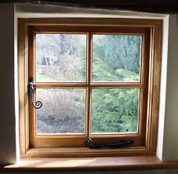
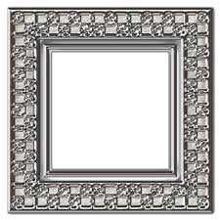
Pictures of real world examples

