Slide 1
SAS and AAS Triangle Congruence Theorems
By: Aldo Astorga

Slide 2
Definition
Side Angle Side: states that if two sides and the included angle of one triangle are congruent to two sides and the included angle of another triangle, then these two triangles are congruent.

Slide 3
Defenition
AAS:two angles and a non-included side of a triangle are congruent to two angles and the corresponding non-included side of another triangle, then the two triangles are congruent. In the figure

Slide 4
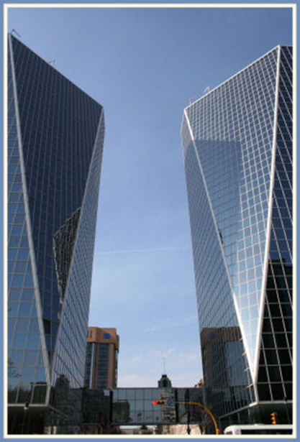
How Does This Apply In Real Life
This Applies in real life in architecture They design Building here the buildings have the AAS postulate (angle angle side) if you don’t do it right the building is gonna fall apart

Slide 5
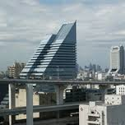
Real Life Example

